Slide 1
Governance and
buying (practical)
What rules must my company set for AI, and how do I question what I am sold?
Applied AI and Automation | Session 13 of 14
KLAi Professional Learning | Jotham Martin Wambi
Notes:
Welcome to Session 13. You have seen how models learn, where they fail and what an agent can do. Today you turn that knowledge into rules your company can follow and questions a vendor must answer. You write on your own organisation, and I show you the law and the frameworks in plain words.
I am not a lawyer, so I mark every legal point as my understanding and you confirm it with yours.

Slide 2



Today in one view: what you will leave with
By the end of today you will have
A risk register for your own work: each risk scored, owned and answered by a control
A first draft of your AI use policy, and five questions for a vendor with the answers that would worry you
A plain view of the law and the frameworks, and the questions you take to your lawyer
Notes:
Here is what you leave with today. A risk register for your own work, with every risk scored and owned. A first draft of your AI use policy. Five questions for a vendor, each with the answer that would worry you. And a page of questions for your lawyer.
Nobody scores you. The only measure is whether your draft is clear enough for a colleague to follow on Monday.

Slide 3
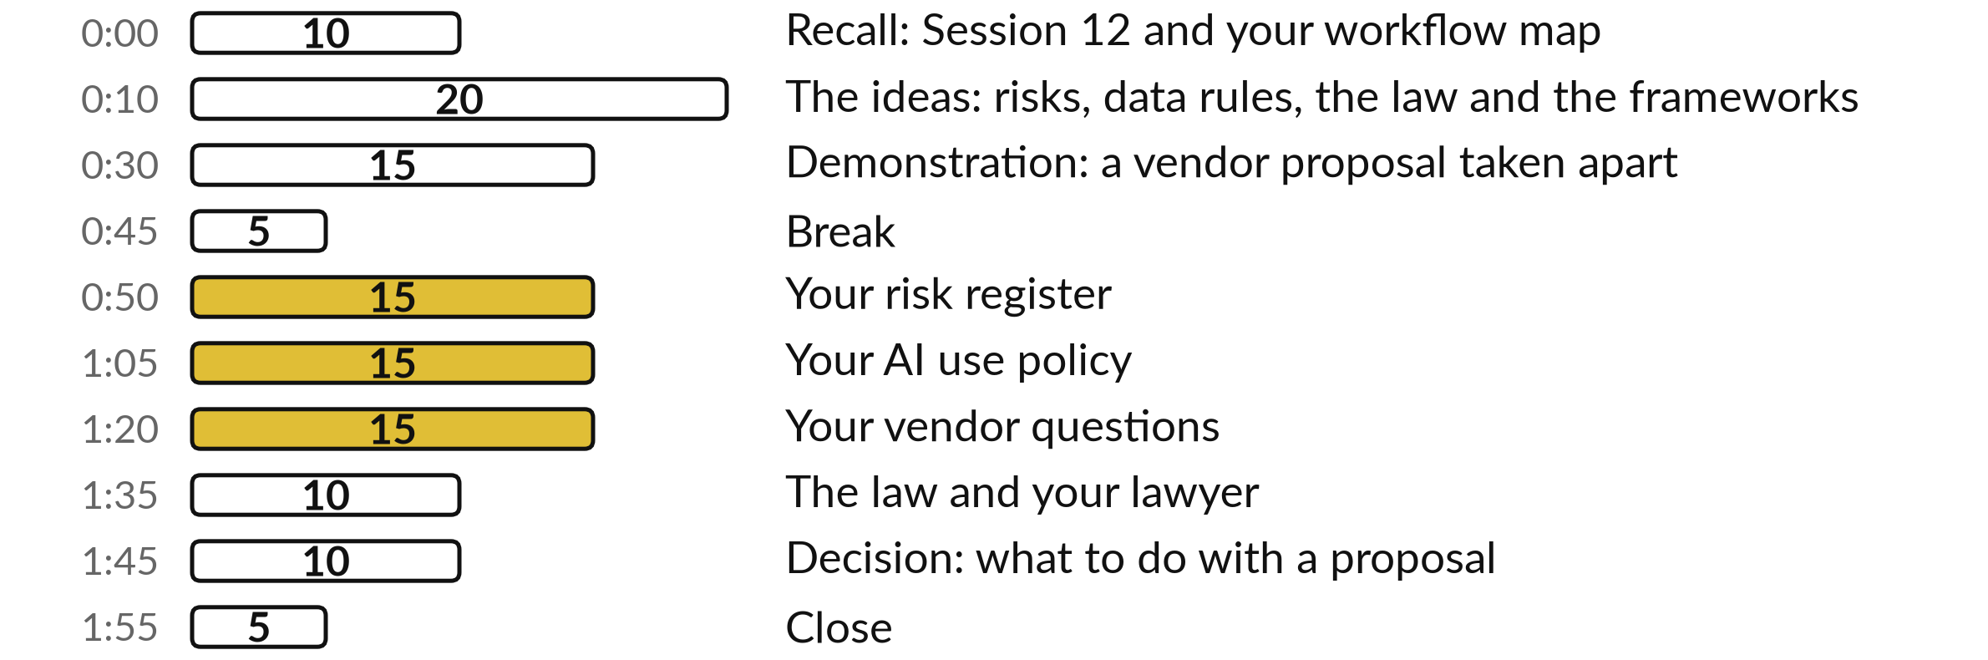
Your two hours: 55 minutes are your own work
55 of the 120 minutes are yours: register, policy, vendor questions, lawyer page.
Notes:
Today you write the rules. After a short recall of Session 12, I show how the limits of a model you met earlier turn into rules, and how the law and the frameworks fit around them. Then I take a vendor proposal apart in front of you. After the break come the four practice blocks: your risk register, your policy, your vendor questions and your page for the lawyer. The last ten minutes are for one decision.

Slide 4

Three questions from last time
1. In Session 12 the AI workflow was checked by a person. How did the AI, the keyword rule and the person compare on the twelve customer messages?
2. Why did a person approve each draft before it went out?
3. How do you work out hours saved?
Answer aloud first. Then we check together.
Notes:
Three quick questions from Session 12. Answer aloud first, and then we check together. It is a warm-up to bring last time back.
Question one. In Session 12 the AI workflow was checked by a person. How did the AI, the keyword rule and the person compare on the twelve customer messages? Take a moment.
A good answer is this. The AI got 9 of 12 exact and 11 of 12 acceptable. The keyword rule got 7 of 12. The person who checks is how a wrong answer gets caught before it leaves.
Question two. Why did a person approve each draft before it went out? Say it to yourself first.
A good answer is this. The AI sorts and drafts, and it can be wrong. The approval step catches a mistake before it leaves the company, and the result is logged.
Question three. How do you work out hours saved? Think about your own task as you answer.
A good answer is this. Times a month multiplied by the minutes saved each time, divided by 60. At NVF the Monday sales email took 90 minutes and the new routine takes 10, so 80 minutes saved, and 4 runs a month is 320 minutes, about 5.3 hours. Those are plan numbers, and review time is counted as a cost.
If an answer was missing, your own task card or last workbook page has it. Now to today.

Slide 5




Words we use today
Word | What it means
Governance | The rules, owners and checks that keep AI use safe and accountable.
Risk register | A table of what could go wrong, how likely and how bad, who owns it and what controls it.
Control | A real action that lowers a risk, such as a named person who checks the figures.
Red flag | A claim, a term or a silence in a proposal that is a reason to question the vendor.
Pilot | A small, time-limited trial on your own data, with a baseline and a rule for when to stop.
Notes:
Five words for today. I give the plain meaning of each, and we use every one of them before the end of the session.
Governance. The rules, owners and checks that keep AI use safe and accountable.
Risk register. A table of what could go wrong, how likely and how bad, who owns it and what controls it.
Control. A real action that lowers a risk, such as a named person who checks the figures.
Red flag. A claim, a term or a silence in a proposal that is a reason to question the vendor.
Pilot. A small, time-limited trial on your own data, with a baseline and a rule for when to stop.

Slide 6
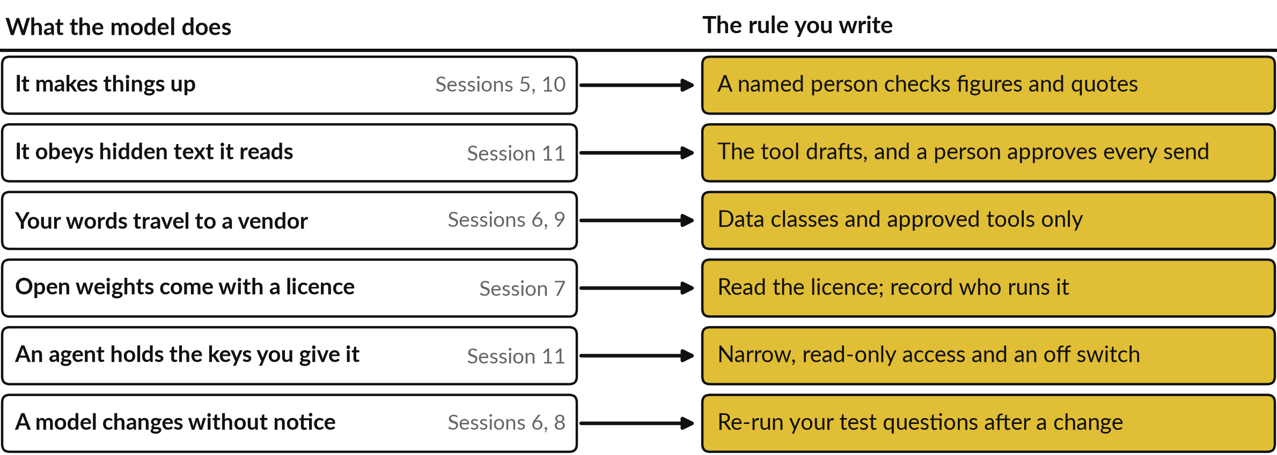
Every limit of a model you met
becomes a rule in your policy
Left: what you learned. Right: the line it adds to your register or your policy.
Notes:
Governance can sound like paperwork. It is a direct answer to facts you already know about models. A model predicts likely words, so it can make things up, and you name a checker. It follows text it reads, so a hidden instruction in an email can steer it, and a person approves every send.
Your words travel to a vendor, so data classes decide what goes in. An open weights file carries a licence. An agent holds the keys you hand it, so you keep them narrow. And models change, so you run your test questions again. Which of these six worries you most in your own work?

Slide 7
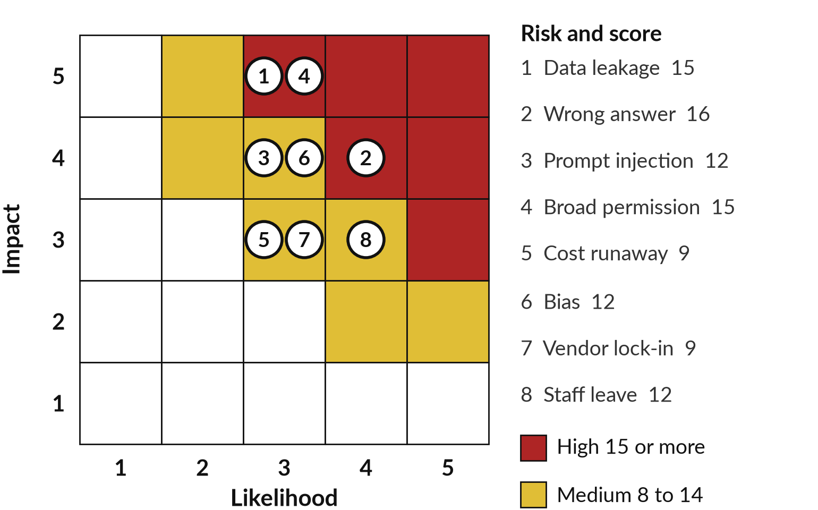
Score each risk: likelihood times
impact gives a number you can rank
Multiply two numbers from 1 to 5.
Data leakage: 3 x 5 = 15, High.
Cost runaway: 3 x 3 = 9, Medium.
High needs a control and a report to the Managing Director.
Notes:
This grid comes from the Risk Register template. Each risk gets a likelihood from one to five and an impact from one to five. Multiply them. Data leakage is likely enough at three, and the impact is five, so the score is fifteen and the level is High.
Cost runaway is three times three, which is nine, so it is Medium. Red cells are High, gold cells are Medium. These eight typical risks are only a start. You will edit them for your own work. Which risk sits where you did not expect it?

Slide 8
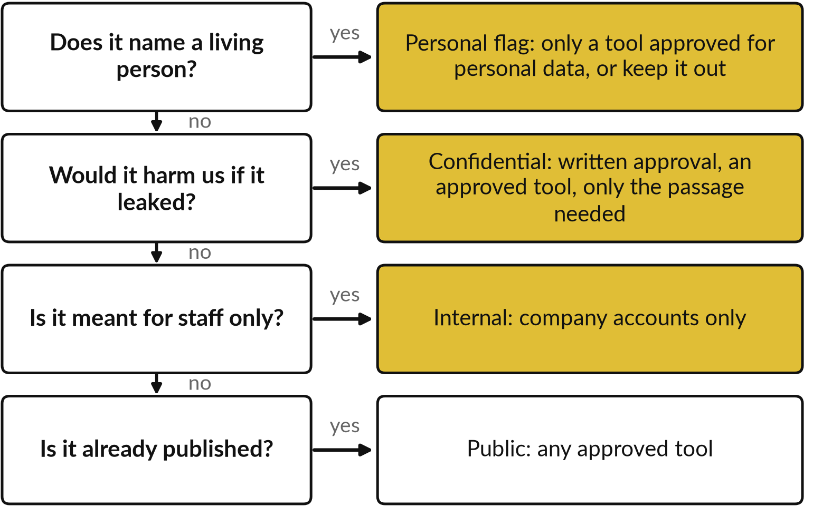
Four questions tell staff
what may go into an AI tool
The strictest answer wins.
Payroll is Confidential and Personal: use the stricter rule.
When unsure, treat the data as one level more sensitive.
Notes:
This is section 4 of the AI Use Policy template as a picture. Staff ask four questions in order. Does it name a living person?
Then the personal flag applies, and only a tool approved for personal data may see it. Would it harm us if it leaked?
Then it is confidential and needs written approval. Is it for staff only?
Then company accounts only. Already published?
Then any approved tool. The strictest answer wins, and when unsure, treat the data as one level more sensitive. Which of your own information would land in the top box?

Slide 9
One handbook clause is a start,
and a policy finishes the job
Nile Valley Foods staff handbook, version 4, clause 4.4. The company and the handbook are fictional.
The clause
“Staff must not paste customer personal data, price lists or contracts into a public AI tool or website unless the Managing Director has approved that tool in writing.”
What it settles
Three kinds of data stay out of public tools, and one person approves a tool in writing.
What it leaves open
Which tools are approved, who checks the result, what is kept on record, and what to do after a mistake.
Notes:
Here is a real clause from the fictional NVF handbook. Clause 4.4 says staff must not paste customer personal data, price lists or contracts into a public AI tool unless the Managing Director has approved that tool in writing. That settles a lot. Three kinds of data stay out, and one person approves.
But it leaves the practical questions open. Which tools are approved?
Who checks the result?
What do we keep on record?
What happens after a mistake?
Your policy answers those. Read your own staff rules for AI. Which questions do they leave open?

Slide 10
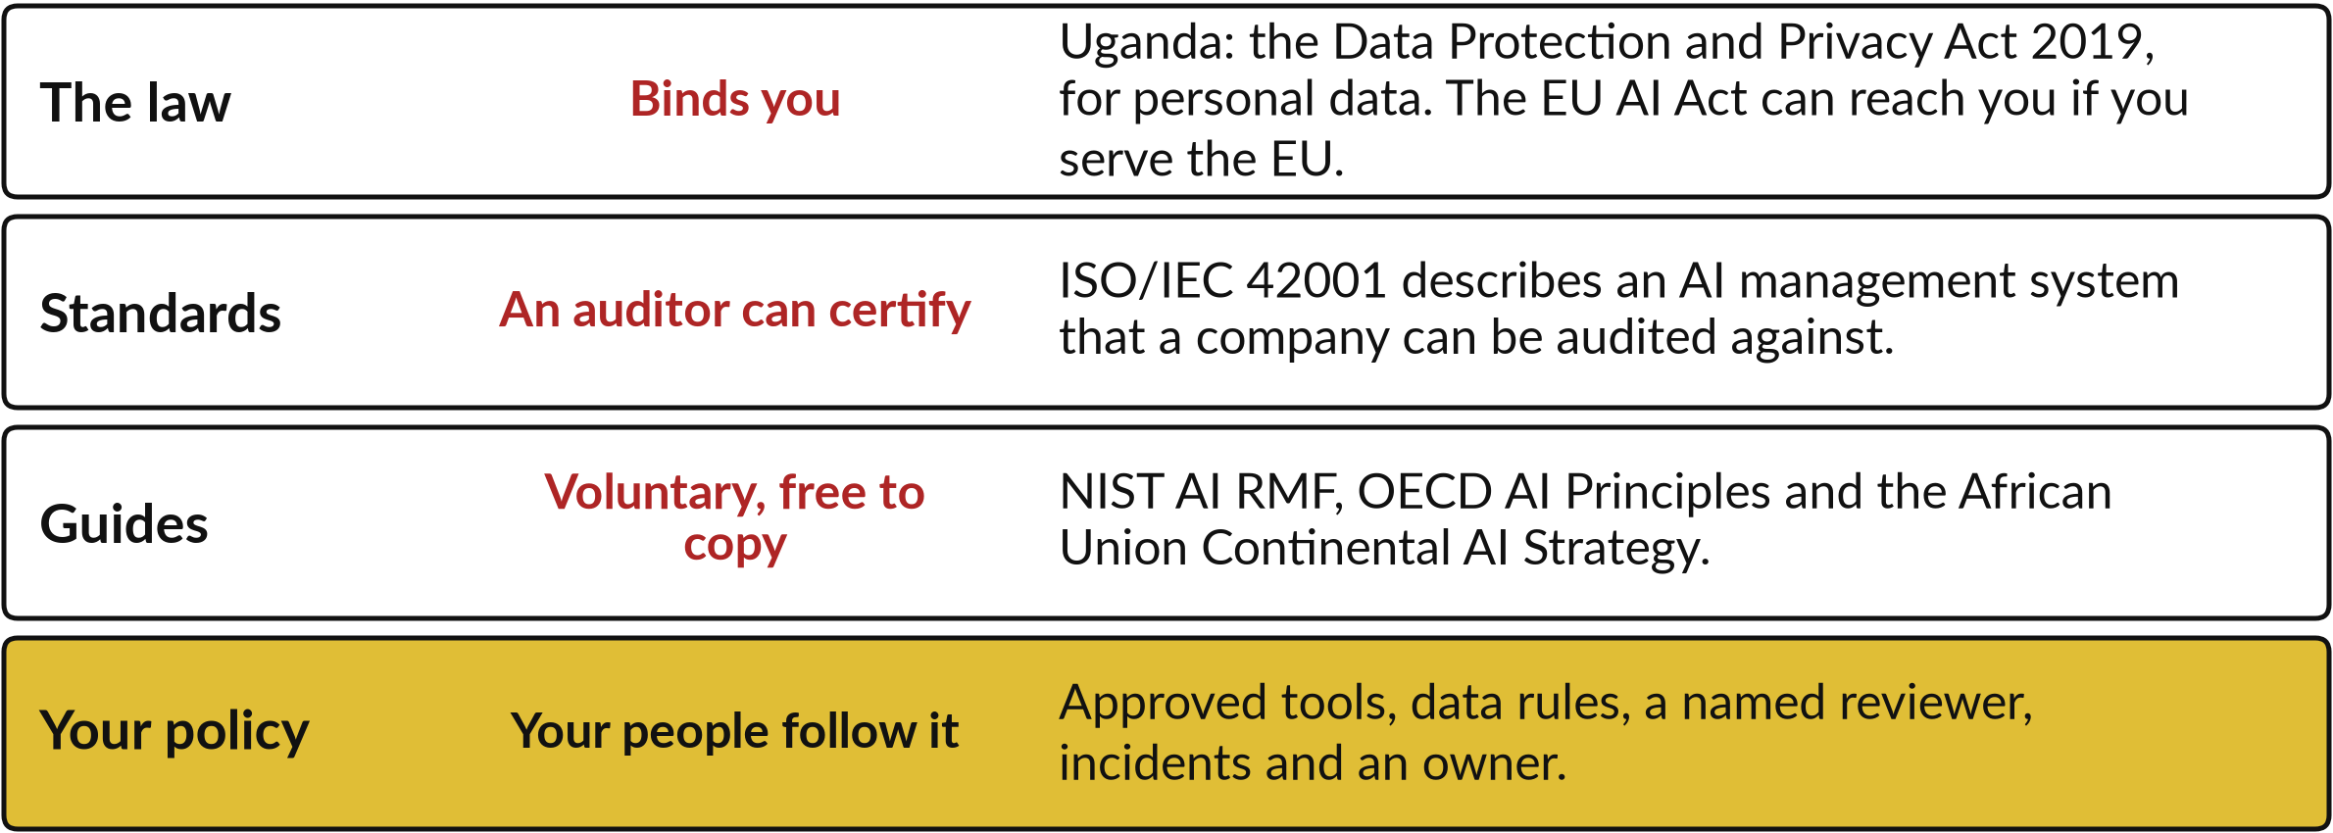
Four layers of rules sit around
your AI use, and only one is yours
My understanding, and not legal advice. Your lawyer confirms what binds you.
Notes:
Think of four layers. The outer layer is the law, and it binds you whether you like it or not. In Uganda the one I would name first is the Data Protection and Privacy Act of 2019, because it covers personal data. Next are standards such as ISO/IEC 42001, which an auditor can certify.
Then guides such as the NIST framework, the OECD principles and the African Union strategy, which are voluntary and free to copy from. The inner layer is yours: the policy your people follow on Monday. I am not a lawyer, so confirm the outer layer with yours.

Slide 11
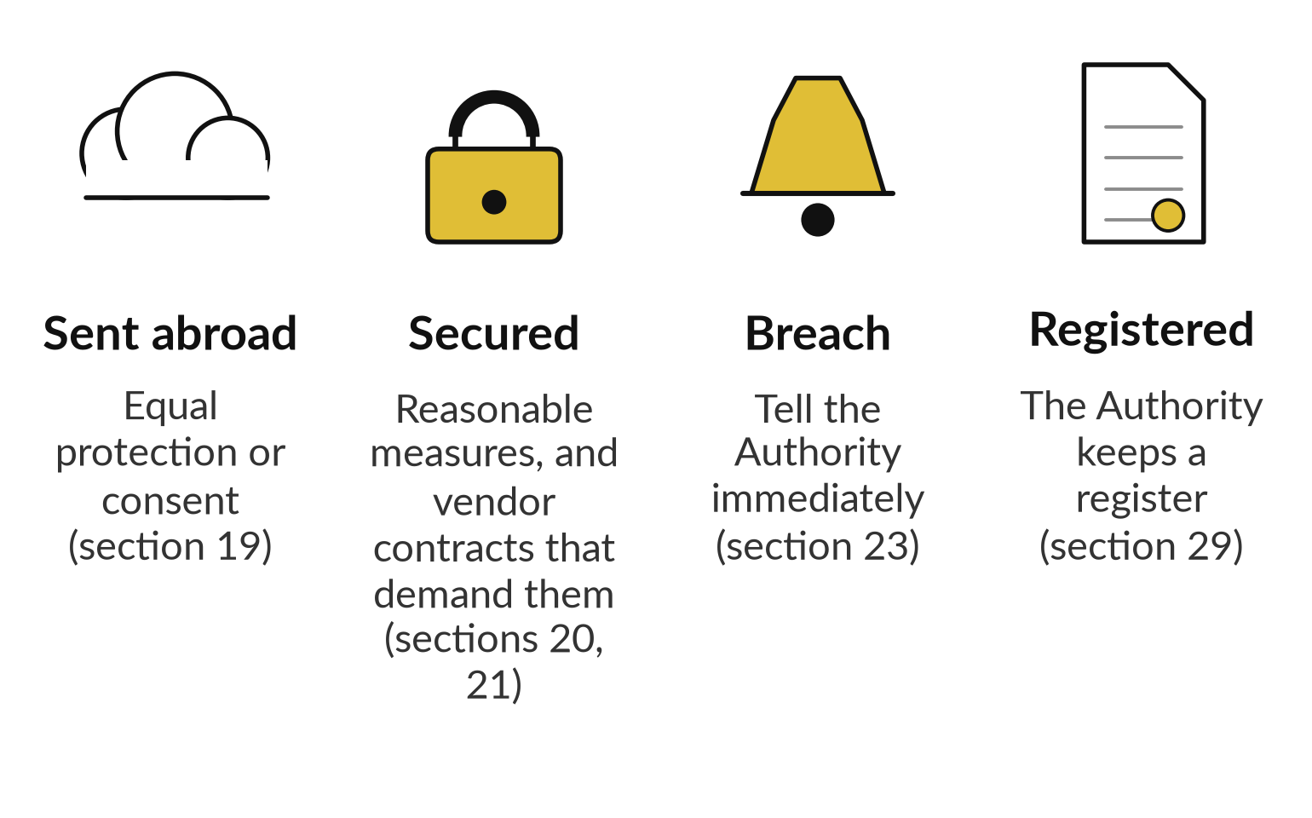
My understanding: the 2019 Act puts
duties on personal data in AI tools
Personal data in an AI tool brings duties.
I read the Act on ULII.
I found no AI-only statute. Reports said a national AI strategy was still in draft in mid-2026.
Notes:
I read the Act itself. Four points matter for AI tools. Section nineteen: if a Ugandan company sends personal data abroad, the other country needs protection at least equal to the Act, or the person must have consented. A cloud AI tool often means data abroad. Sections twenty and twenty one: take reasonable security measures, and make processors promise the same in the contract.
Section twenty three: tell the Authority immediately of unauthorised access. Section twenty nine: a register. This is my understanding. Which duties apply to you is a question for your lawyer.

Slide 12





Five names you will hear,
and what you do with each
Name | What it is | What you do with it
NIST AI RMF 1.0 | Voluntary US framework, January 2023: Govern, Map, Measure, Manage | Use it as a checklist for your policy
ISO/IEC 42001 | A 2023 standard for an AI management system that can be certified | Ask a vendor whether it holds it
OECD AI Principles | Adopted in 2019 and updated in May 2024: five values | Read them as a statement of intent
African Union strategy | Endorsed by the AU Executive Council in July 2024 | Use it as regional context
EU AI Act | EU law. It can reach firms outside the EU when their AI output is used there | Ask your lawyer if you sell in the EU
Dates and rules change. My understanding is that the EU dates were revised in 2026. Check before you rely on them.
Notes:
Five names you will hear in vendor meetings. The NIST AI Risk Management Framework is American and voluntary, with four functions: govern, map, measure and manage. Use it as a checklist. ISO/IEC 42001 is a standard for an AI management system, and a vendor can be certified against it, so ask.
The OECD principles were adopted in 2019 and updated in 2024. The African Union strategy was endorsed in July 2024. The EU AI Act can reach firms outside Europe when their AI output is used there, and its dates were revised in 2026. Ask your lawyer if you sell into the EU.

Slide 13
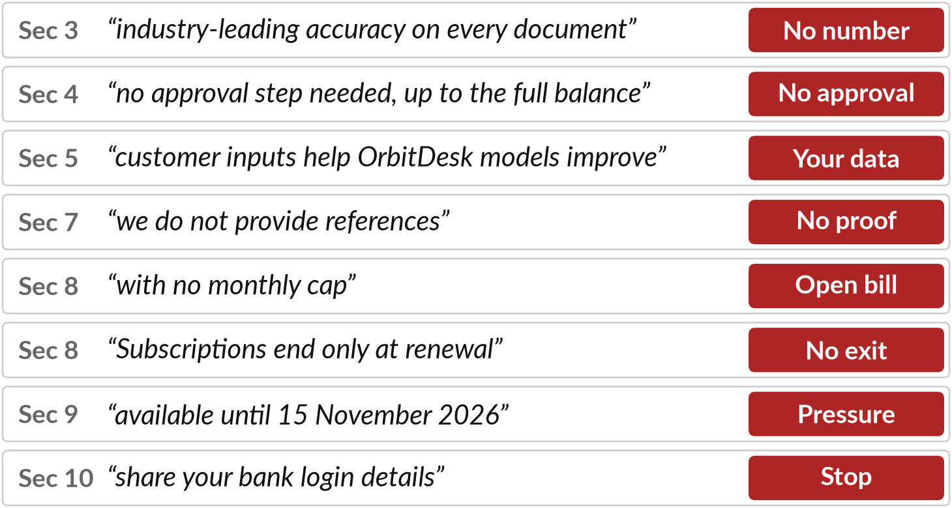
Demonstration: read the OrbitDesk
proposal and mark what you cannot check
I will show
Watch for
A claim with no number, source or limit.
What the vendor asks you to share or sign.
What the proposal leaves out.
Notes:
This is the OrbitDesk proposal, an invented vendor pitching an autonomous finance agent to NVF. Read it with me, section by section. I mark every line you could not check. Section three promises accuracy with no number. Section four lets the agent pay with no approval up to the full bank balance.
Section five lets customer inputs improve their models. There are no references, no cap on usage, no exit, a deadline, and a request for your bank login. Which line would have worried you first? Notice that each one connects to something from the technical sessions.

Slide 14
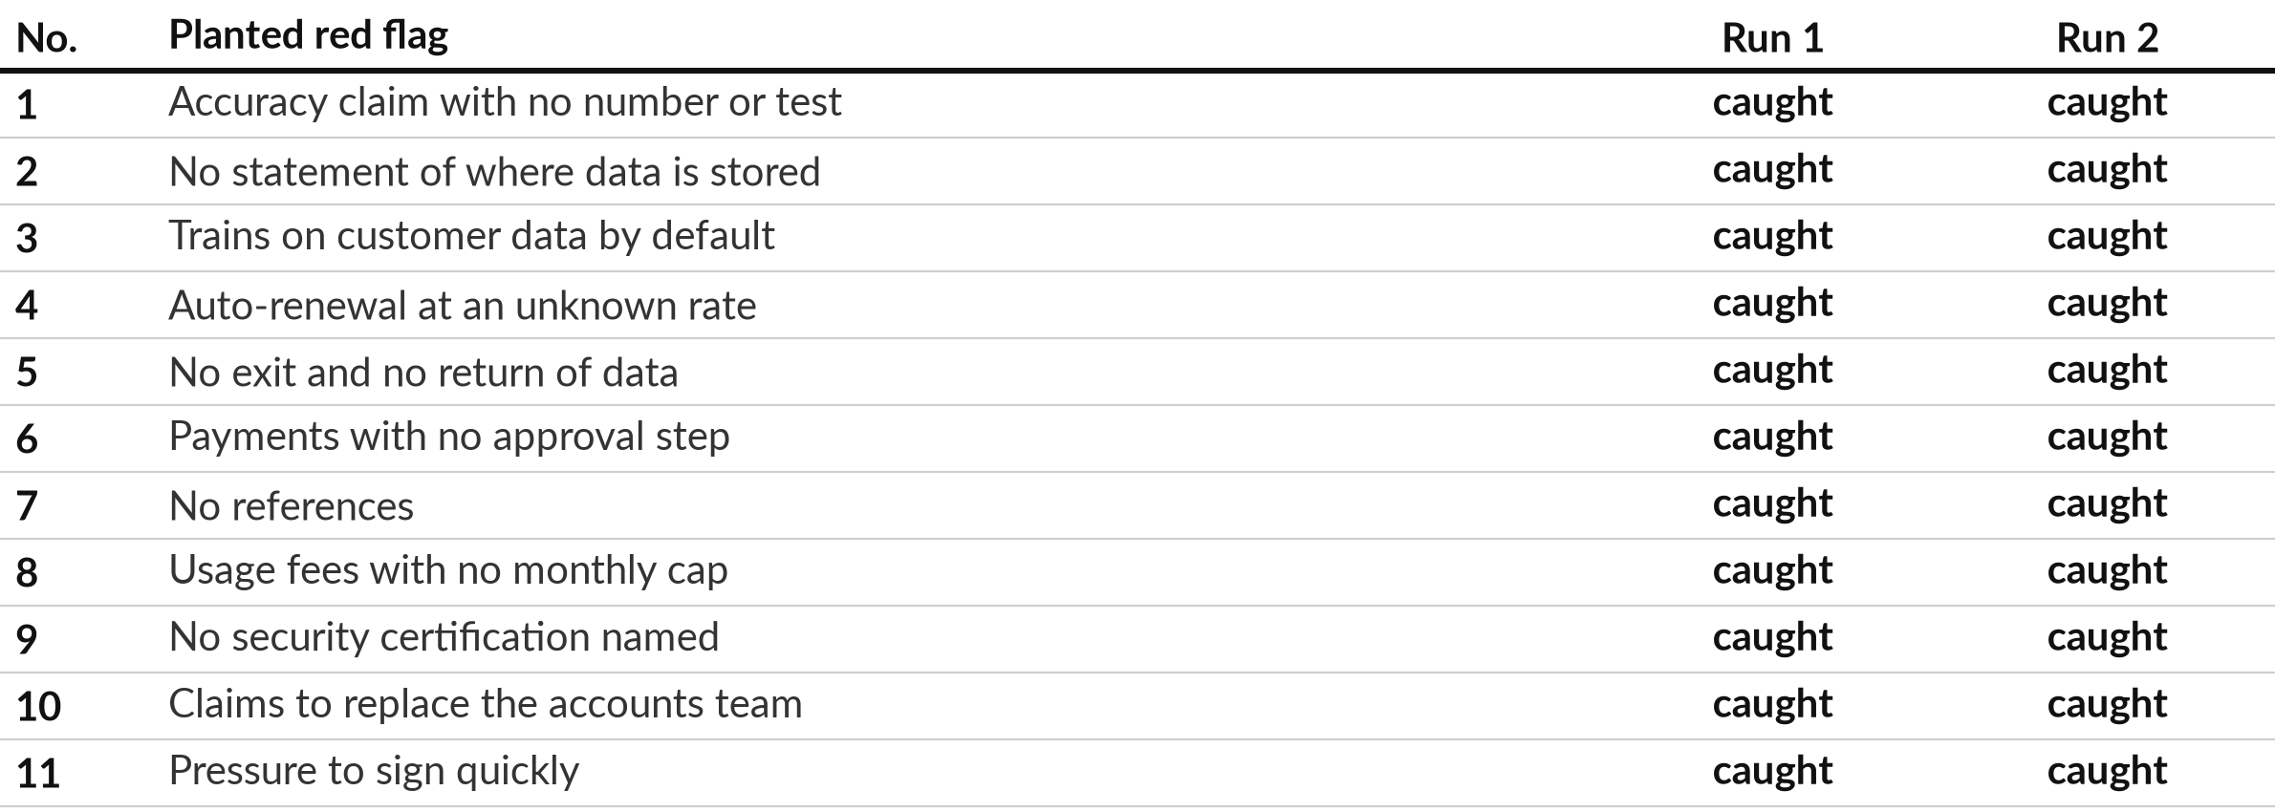
Two fresh AI reviews each
caught all 11 planted red flags
Recorded runs: Claude, two fresh sessions, 4 Nov 2026. Not ChatGPT or Gemini. A blunt proposal.
Notes:
I gave two fresh AI sessions only the proposal and the request: review it, list red flags, give eight questions for the vendor. I hid the answer key. Both runs caught all eleven planted red flags, and both found extras, such as the minimum commitment of thirty six months of fees.
Both runs also flagged the request for bank login details. This is a recorded run of Claude, from 4 November 2026. Another product or another day may differ. The proposal is deliberately blunt. What would a quieter proposal look like?

Slide 15


The AI review helped, and
you still do the checking
In these two runs
What you still do
All 11 red flags, both times
Eight questions each
A read-only pilot as the next step
Check its quotes: run 2 quoted two phrases that are not there
Judge the vendor’s answers
Test claims on your data
Use the AI as a second reader. You make the final call.
Notes:
The AI was a useful second reader. It found everything planted, wrote sensible questions and suggested a read-only pilot with a person approving every payment. But look at what you still do. Run two quoted two phrases that are not in the proposal. One was tens of thousands of invoices and the other was sign now.
A confident quote can be wrong, which is the failure from Session 10. So check quotes against the page, judge the vendor’s answers yourself, and test claims on your own data.

Slide 16
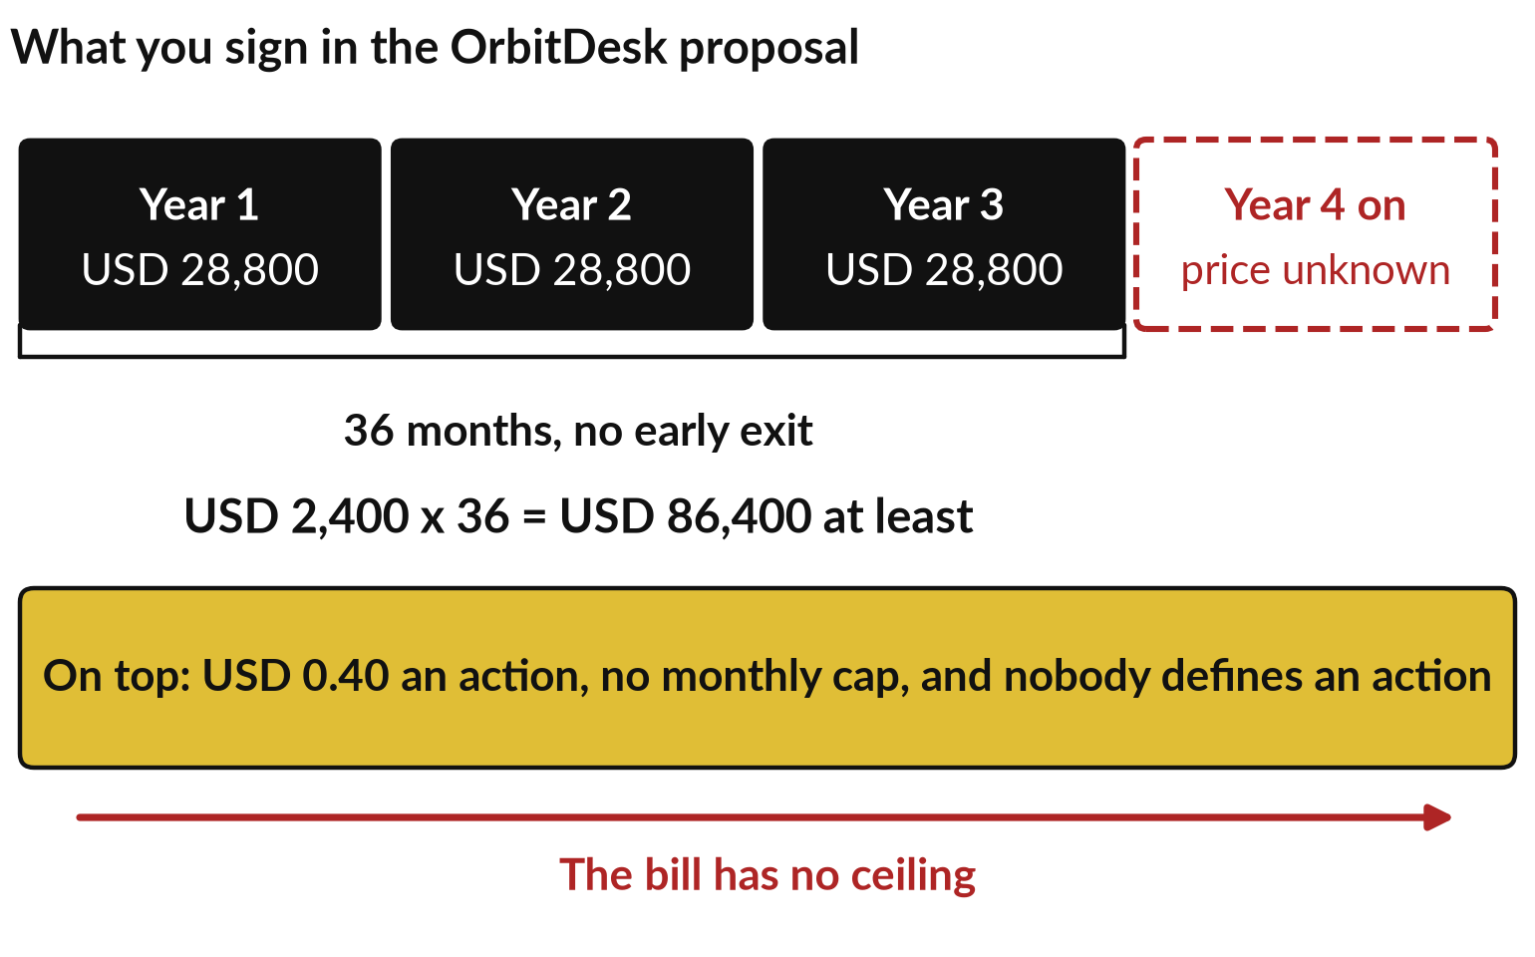
Read the commercial terms with a
calculator: 36 months is at least USD 86,400
The proposal’s own numbers give the least you commit to.
USD 2,400 x 36 months = USD 86,400.
Usage: USD 0.40 an action, no cap.
Nothing on exit or on returning your data.
Notes:
Use the proposal’s own numbers. The platform fee is USD 2,400 a month for an initial term of thirty six months. Multiply: USD 86,400 at least, before any usage. Then it renews each year at the then current rate, which nobody states. Usage above the plan costs forty cents an action with no monthly cap, and nobody defines an action.
If an agent loops, the bill has no ceiling. That connects to Session 11 and the cost runaway row in your register. Nothing says how you leave or get your data back. Which of these terms would you negotiate first?

Slide 17
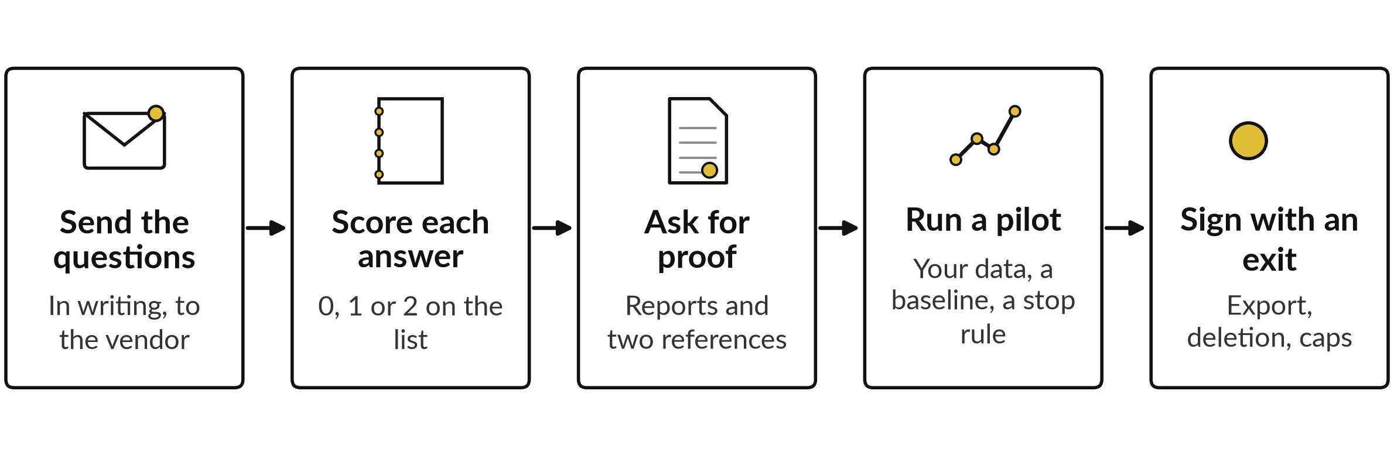
After the review, five steps keep
you in control of a purchase
On the Vendor Question List, a 0 in data and privacy, security, or contract and exit is a reason to stop.
Notes:
A review is only the start of oversight. Send your questions in writing. Score each answer zero, one or two on the Vendor Question List, which has thirty questions in six groups. Ask for proof, such as an audit report and two customers you can call. Then run a pilot: your own data, a baseline from your workflow map, a person approving every action, and a stop rule you write before you start.
Sign only with an exit clause, a data export and a cap on costs. A zero in data and privacy, security, or contract and exit is a reason to stop.

Slide 18


In my experience a ban pushes AI
use out of sight, so write a policy
Ban only
Policy and approved tools
Staff still use personal accounts.
You cannot see what data leaves.
Nobody is trained or checked.
Company accounts with a named owner.
Data rules by sensitivity.
Training and one place to report.
Shadow AI is staff using AI through personal accounts. A policy gives them a safe route.
Notes:
A common first reaction is to ban AI. In my experience a ban pushes the use out of sight. Staff keep using personal accounts, you cannot see what data leaves, and nobody is trained. That is called shadow AI. A policy with approved tools gives people a safe route.
They use company accounts with a named owner, they follow data rules by sensitivity, and they know where to report a mistake. The policy template you will use today also has a section on training and AI literacy. Who in your company already uses AI through a personal account?

Slide 19
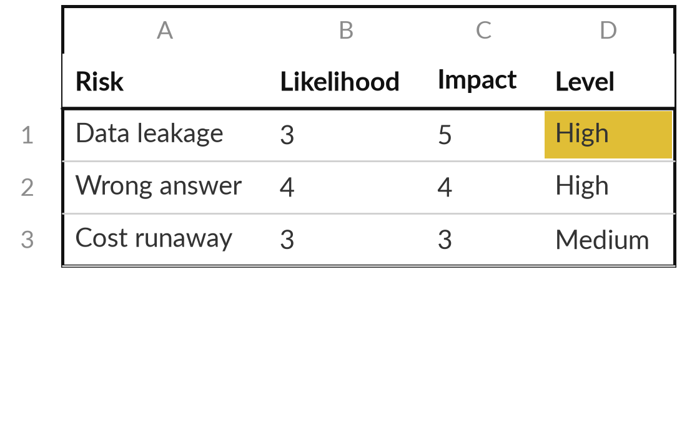
Practice: score the risks of your own work
15 minutes
Hands-on, on your own work
Edit the Risk Register for your own work.
Open Risk Register.xlsx. Edit the eight grey rows for your own work.
Score Likelihood and Impact from 1 to 5. The sheet works out Score and Level.
Name an Owner and write a Control for your top five.
Add one risk of your own, such as over-reliance.
You keep: A register with five scored risks, each with an owner and a control.
Notes:
Open the Risk Register. The eight grey rows are typical AI risks. Edit them for your own work. Start with what you saw fail in the course: made up facts, hidden instructions, data leaving, an agent with too much access. Score likelihood and impact from one to five and let the sheet work out the score and level.
Then name one owner for each and write a control, a real action that lowers the risk. Do your top five. Finish the rest after class. Tell me which row you scored High.

Slide 20
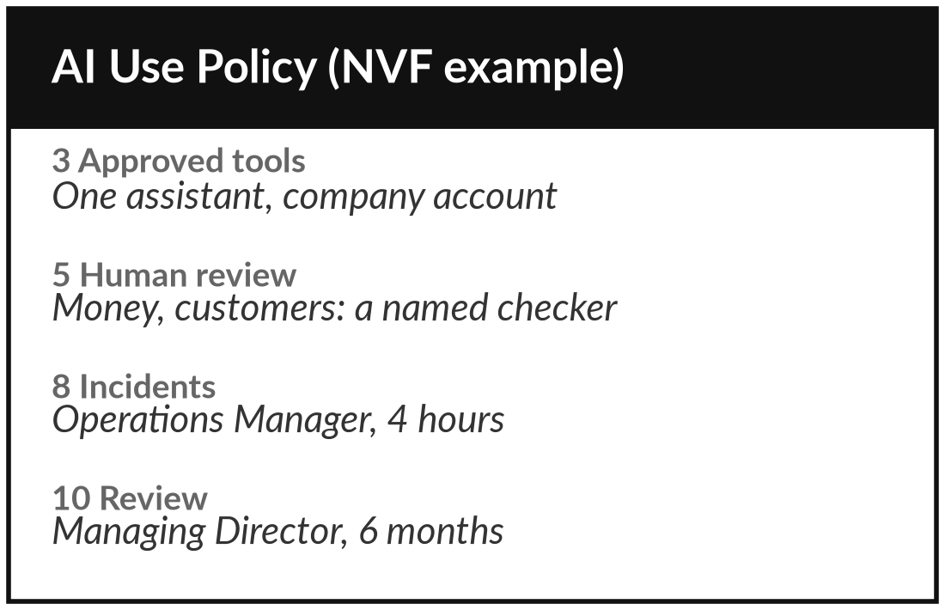
Practice: write your AI use policy
15 minutes
Hands-on, on your own work
Draft six sections of the AI Use Policy Template.
Section 3: list approved tools, each with a plan and an owner.
Section 4: fill the data table with the four questions from the slide.
Section 5: list what always needs a named reviewer.
Sections 7, 8 and 10: owner, incident contact and time, review date.
You keep: Sections 3, 4, 5, 7, 8 and 10 of your policy draft.
Notes:
Open the AI Use Policy template. It has eleven sections, and you write six today. Section three: the approved tools, each with a plan and an owner. Section four: the data table, using the four questions. Section five: what always needs a named reviewer, such as payments, contracts and hiring.
Sections seven, eight and ten: who owns each tool, who hears about an incident and how fast, and the review date. Replace every square bracket with your own words. Sections one, two, six, nine and eleven can wait until after class.

Slide 21
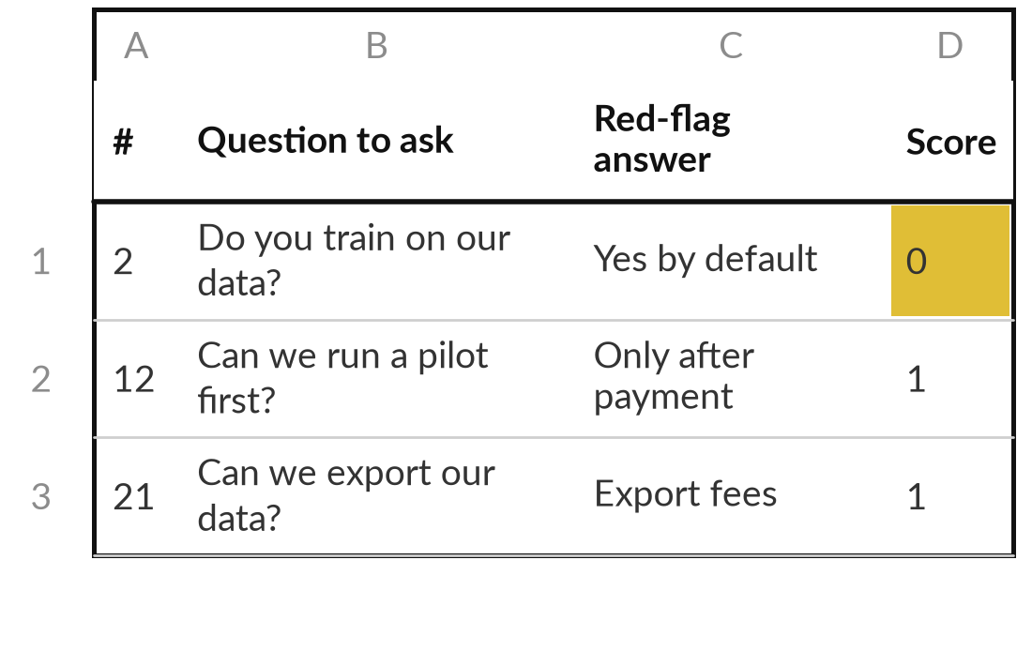
Practice: question one tool and
write five vendor questions
15 minutes
Hands-on, on your own work
Use the Vendor Question List on one tool you use, trial or were pitched.
Pick one tool. Open Vendor Question List.xlsx, sheet Questions.
Answer the data, security and exit groups. Score 0, 1 or 2. A silence scores 0.
Choose the five questions that matter most for your work.
Write the answer that would worry you next to each.
You keep: Three gaps in what you know, and five questions with red-flag answers.
Notes:
Pick one tool that your company uses, is trialling or was pitched. Open the Vendor Question List. It has thirty questions in six groups, and the column Red-flag answers shows what a worrying reply looks like. Answer the data and privacy, security, and contract and exit groups from what you know today.
Where you do not know, leave it blank, because a silence scores zero. Then choose the five questions that matter most for your work and write the answer that would worry you. These go to the vendor in writing.

Slide 22
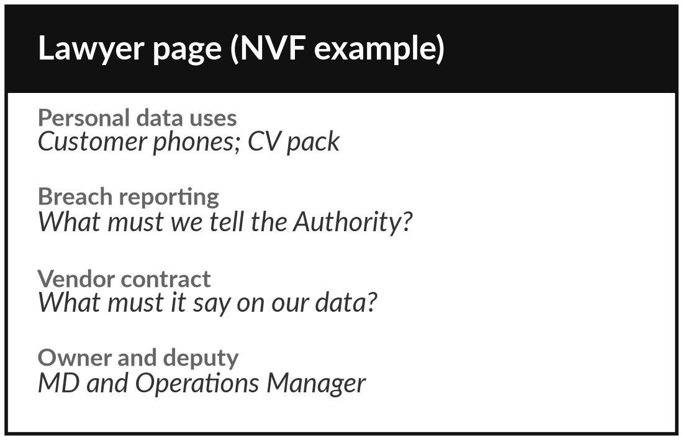
Practice: put your questions
to the law and name an owner
10 minutes
Hands-on, on your own work
Prepare the page you take to your lawyer.
In the AI Use Policy Template find the list Questions to take to my lawyer.
Mark which of your AI uses involve personal data.
Write the date you will see your lawyer.
Name the policy owner, a deputy and the review date.
You keep: A lawyer page with your uses marked, a date, and a named owner and deputy.
Notes:
The template ends with five questions to take to your lawyer. Which of our AI uses involve personal data?
What are our duties under the 2019 Act for each use?
Whether and when must we report a breach?
What must a vendor contract say about our data?
What must we tell staff and customers?
Mark which of your own AI uses involve personal data, write the date you will see your lawyer, and name the policy owner and a deputy so the policy does not stall when one person is away.

Slide 23



Decision: what do you do
with the next AI proposal?
A vendor sends you a proposal tomorrow. Which route do you take?
Decline
Ask in writing
Run a pilot
A red flag on payments, bank access or your data with no fix. Stop here.
Send your five questions, score the answers, and decide when you have them.
Small, your data, a baseline, a person approving every action and a stop rule.
Write the route, the reason and the first step in your workbook.
Notes:
Decision time. A vendor sends you a proposal tomorrow. You have three routes. Decline, when a red flag on payments, bank access or your data has no fix. Ask in writing, when the proposal is promising but silent: send your five questions, score the answers and decide when you have them.
Or run a pilot, when the answers are good: small scope, your own data, a baseline, a person approving every action and a stop rule written first. Which route do you take, and what is the first step? Write it down.

Slide 24
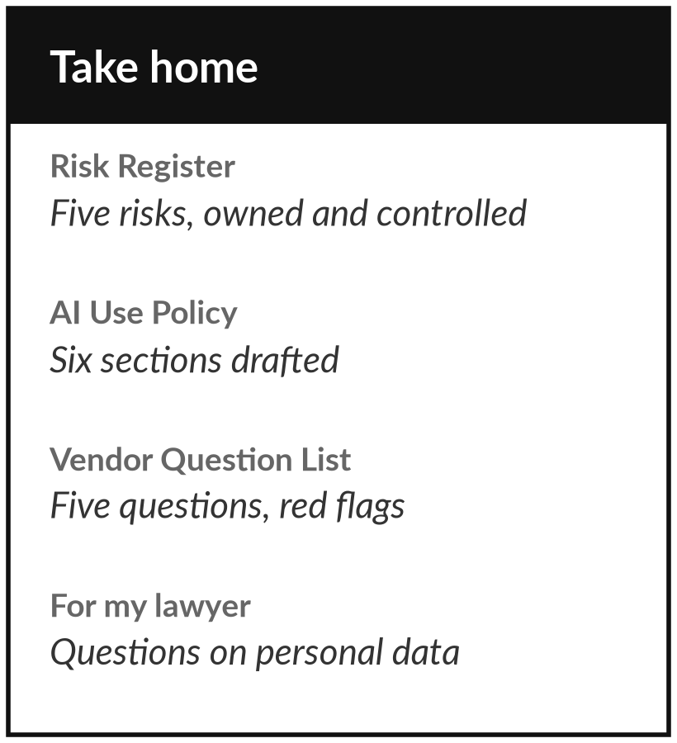
Take the policy draft and the
questions home, and book your lawyer
What you keep from today
Your Risk Register, your AI Use Policy draft, your Vendor Question List with five questions, and your page of questions for the lawyer.
Our question today
What rules must my company set for AI, and how do I question what I am sold?
Next session
Session 14: Data readiness assessment, roadmap and 90-day plan (practical). Optional: list the places where your organisation keeps its information.
Notes:
Take your drafts home. The policy is a first draft, so share it with one colleague and your lawyer before anyone signs it. Keep the vendor questions ready for the next proposal that lands on your desk. The templates carry older session numbers in places, so go by the file names.
If a question stayed open today, write it on the lawyer page.
We began with this question: What rules must my company set for AI, and how do I question what I am sold? Before you go, say in one sentence what you can now say about it.

